Slide 1

Price Hike Control

Slide 2
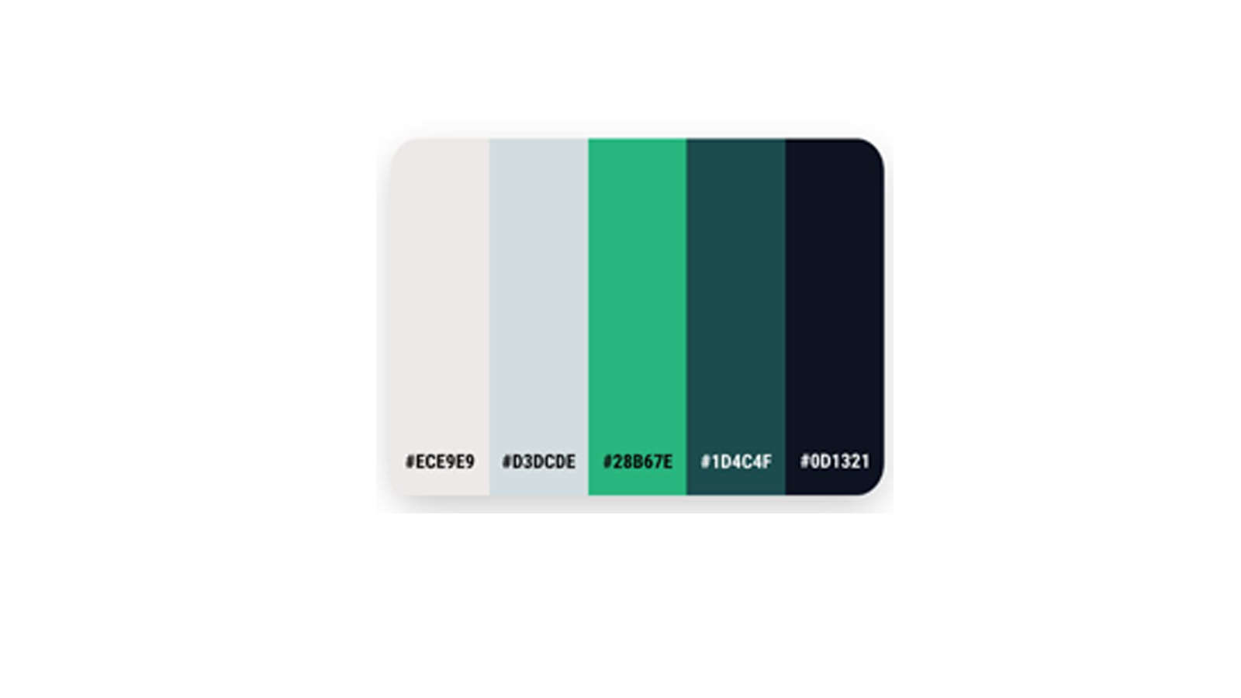
Color Palette:
Due to Government Projects color palette chosen as Green Shade.

Slide 3

Starting Page

Slide 4
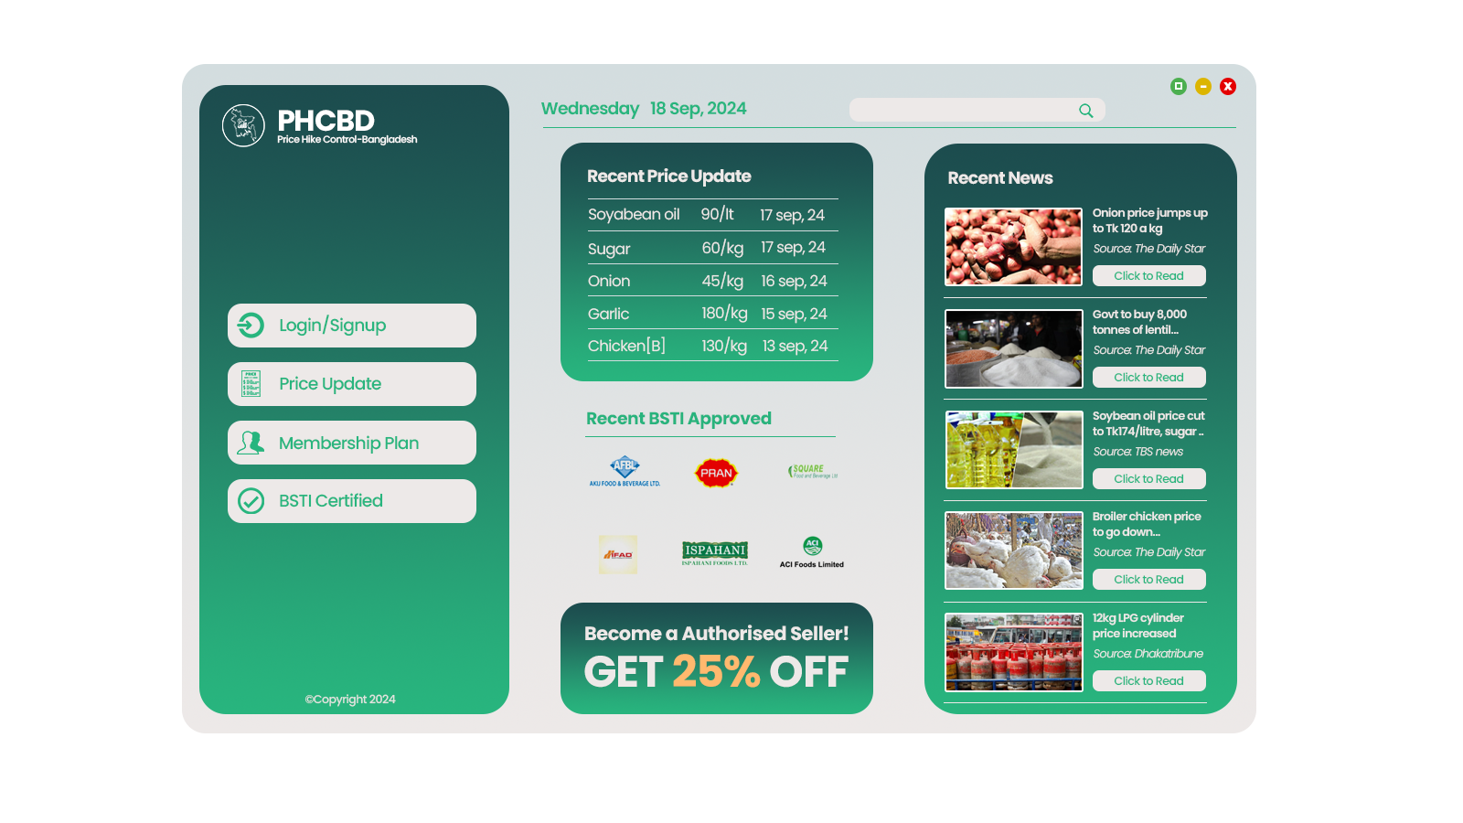
Home Page

Slide 5
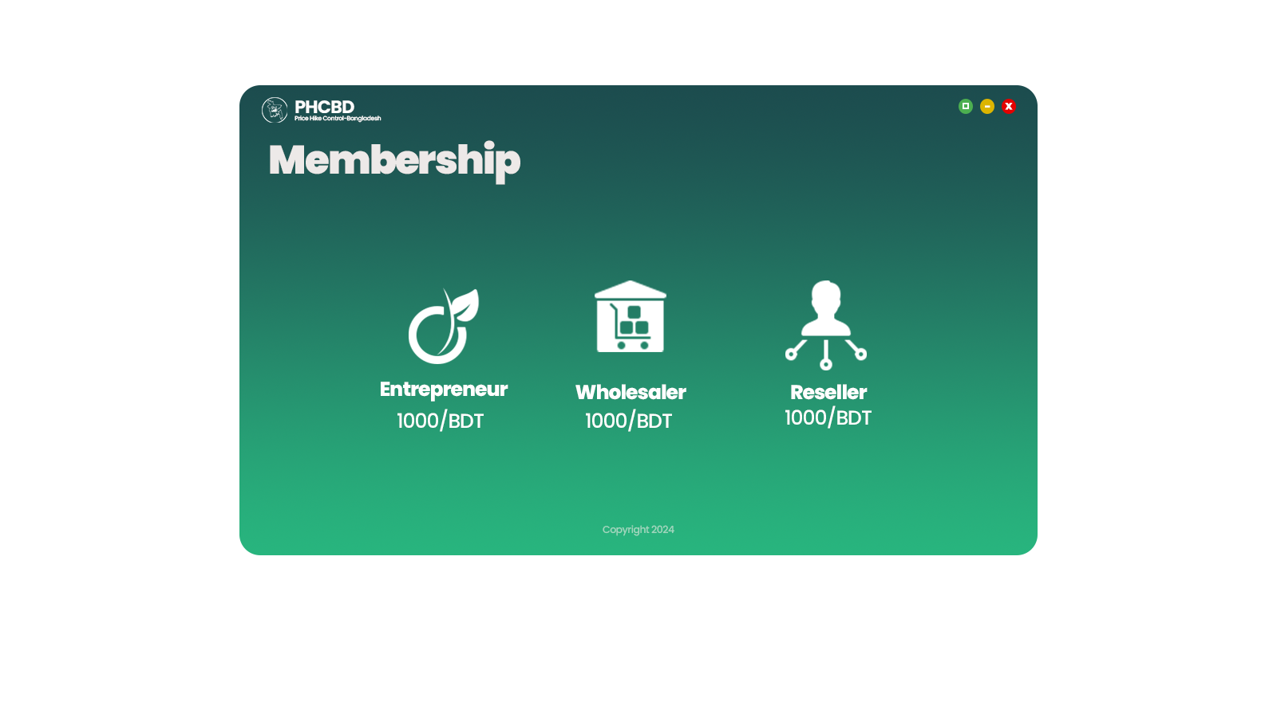
Membership Page

Slide 6
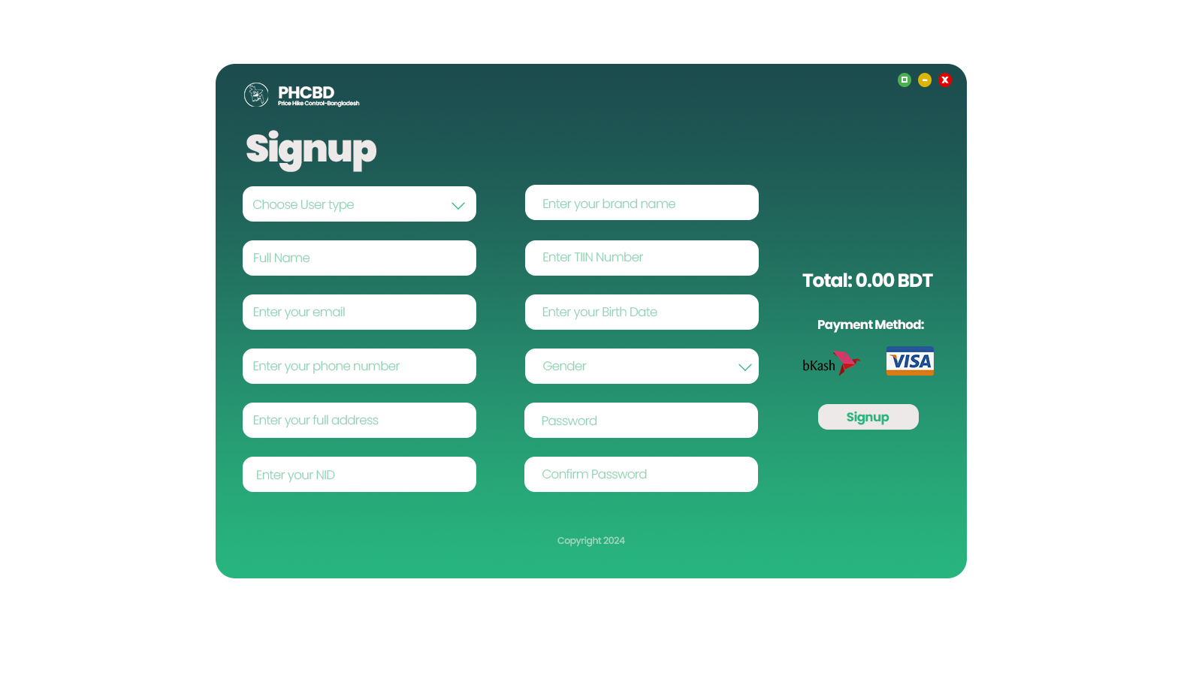
Reseller
Wholesaler
Entrepreneur
Signup Page

Slide 7
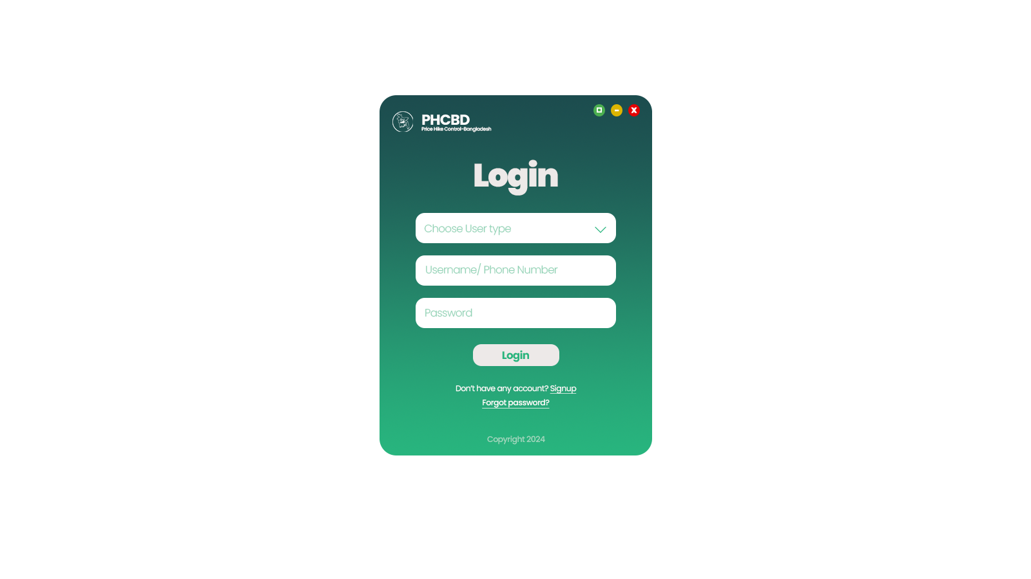
Reseller
Wholesaler
Entrepreneur
Login Page

Slide 8
Home Page

Slide 9
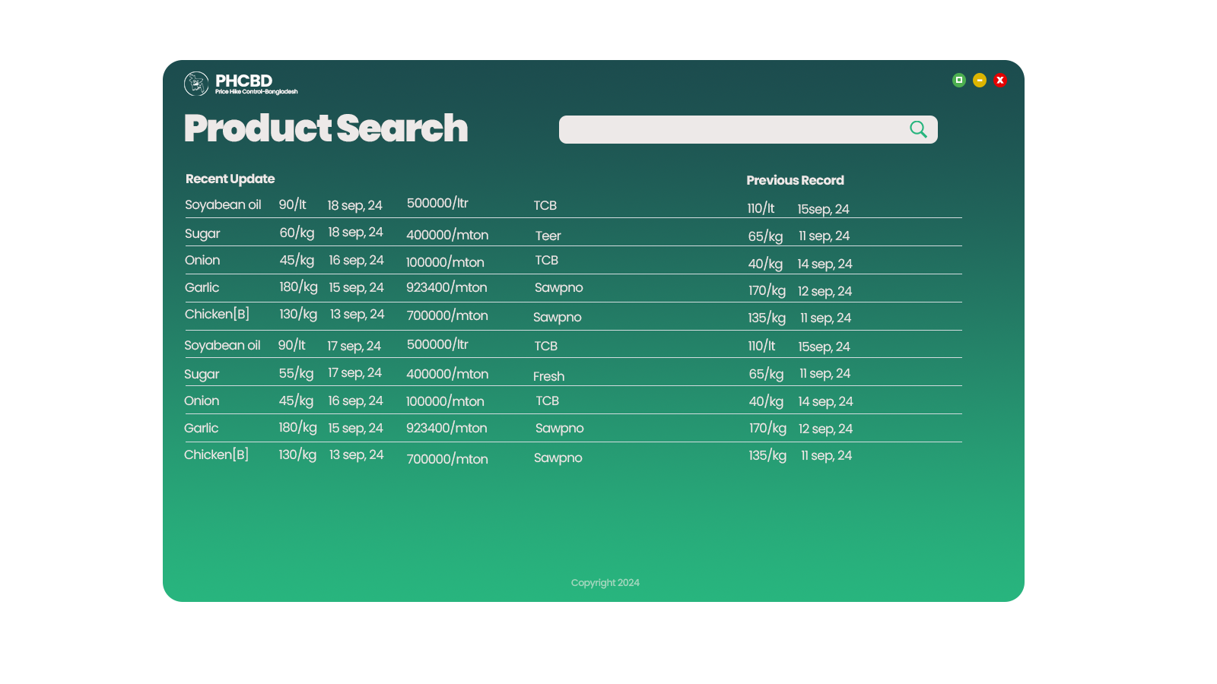
Product Search Page

Slide 10
Things to concern:
Regular Monitoring
Physical Stock monitoring
Reach out to mass people or Rural area
Mobile App or a Responsive app needed

